Slide 1

UE23CS320B – Capstone Project Phase – 2
SEMESTER - VI
END SEMESTER ASSESSMENT
Project Title : PhishGuard AI - Local Browser Extension for Real-Time Phishing & Deepfake Detection Using a Multi-Modal, Correlation-Aware Pipeline
Project ID : PW26_RR_06
Project Guide : Dr. Roopa Ravish
Project Team : Mallikarjun Reddy
Navajyoth
Pranav G M
N Viharika

Slide 2
PhishGuard AI - Local Browser Extension for Real-Time Phishing & Deepfake Detection Using a Multi-Modal, Correlation-Aware Pipeline
Outline
Abstract and scope.
Suggestions from phase-2 review 2
Implementation details (Technical)
Results and demo
Project Progress Plan for Phase 3 and Phase 4
References
Any other Information

Slide 3
PhishGuard AI - Local Browser Extension for Real-Time Phishing & Deepfake Detection Using a Multi-Modal, Correlation-Aware Pipeline
Abstract and Scope
Problem: Single-modality phishing detection (e.g., just checking URLs) fails against modern, multi-layered attacks like deepfakes and visually deceptive clones.
Solution: A Multi-Modal Phishing Detection System that mathematically fuses Text, URL, Visual (DOM), and Audio/Video analysis.
Scope: Real-time web analysis via a Manifest V3 Browser Extension, backed by a Python/Flask Cloud Fusion Engine and Vertex AI Gemini for human-readable threat explanations.

Slide 4
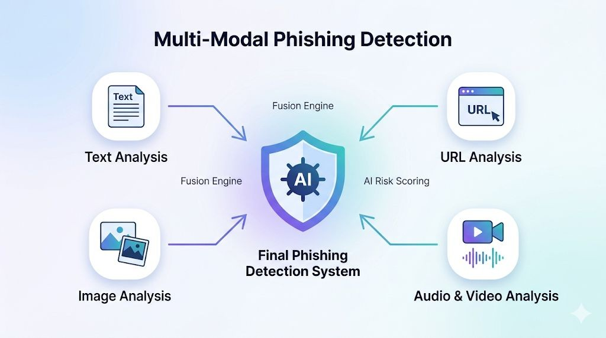
PhishGuard AI - Local Browser Extension for Real-Time Phishing & Deepfake Detection Using a Multi-Modal, Correlation-Aware Pipeline
Abstract and Scope
*(INSERT IMAGE HERE: A professional, high-level infographic or icon set showing 4 inputs (Text, URL, Image, Video) combining into a single shield icon).*

Slide 5
PhishGuard AI - Local Browser Extension for Real-Time Phishing & Deepfake Detection Using a Multi-Modal, Correlation-Aware Pipeline
Suggestions from Phase 2- review 2
Suggestion 1: "Ensure the system can detect deepfake video payloads natively, rather than just relying on text/URL heuristics."
Feasibility/Progress: Implemented structural DOM parsing to intercept <video> and <audio> tags. Transcoded demo videos to H.264 for seamless browser integration.

Slide 6
PhishGuard AI - Local Browser Extension for Real-Time Phishing & Deepfake Detection Using a Multi-Modal, Correlation-Aware Pipeline
Suggestions from Phase 2- review 2
Suggestion 2: "Improve latency; cloud processing takes too long for real-time browsing."
Feasibility/Progress: Shifted from cloud-rendering full screenshots to client-side DOM extraction. Average inference time reduced to <200ms on Render.com

Slide 7
PhishGuard AI - Local Browser Extension for Real-Time Phishing & Deepfake Detection Using a Multi-Modal, Correlation-Aware Pipeline
Implementation Details
Frontend: React-based UI & Manifest V3 Chrome Extension.
Backend: Flask REST API deployed on Render.com.
Machine Learning Models:
Text: DistilBERT (Transformer-based NLP).
URL: Ensemble statistical classifier.
Visual/Media: DOM-structure heuristics & CNNs.
Fusion Engine: Computes Cosine Similarity between modality embeddings. Uses Dynamic Weighting to penalize conflicting anomalies and boost correlated threats, drastically reducing false positives.

Slide 8
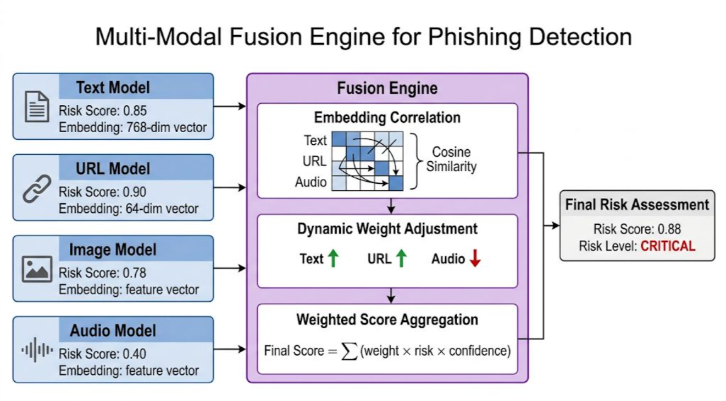
PhishGuard AI - Local Browser Extension for Real-Time Phishing & Deepfake Detection Using a Multi-Modal, Correlation-Aware Pipeline
Implementation Details

Slide 9
PhishGuard AI - Local Browser Extension for Real-Time Phishing & Deepfake Detection Using a Multi-Modal, Correlation-Aware Pipeline
Results and demo
Successfully intercepted deepfake media and credential harvesting clones that bypassed standard URL blacklists.
Performance: System classifies threats in ~150-200ms post-spin-up.
Explainability: Vertex AI successfully translates mathematical SHAP values into readable UI explanations.

Slide 10
PhishGuard AI - Local Browser Extension for Real-Time Phishing & Deepfake Detection Using a Multi-Modal, Correlation-Aware Pipeline
Results and demo
System Output Categorization & Action Protocols
🔴 Critical (Score ≥ 0.8): Imminent threat detected. System mandates zero interaction and blocks the page.
🟠 High Risk (Score ≥ 0.6): Very suspicious with a high probability of phishing.
🟡 Medium Risk (Score ≥ 0.4): Mixed signals detected. Users are warned to proceed with caution and verify the source.
🔵 Low Risk (Score ≥ 0.2): Generally safe, though minor awareness is recommended.
🟢 Safe (Score < 0.2): No recognized threats detected by the fusion engine.

Slide 11
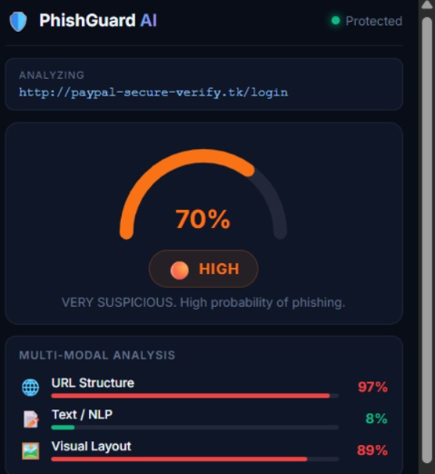
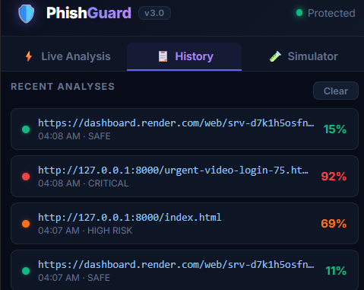
PhishGuard AI - Local Browser Extension for Real-Time Phishing & Deepfake Detection Using a Multi-Modal, Correlation-Aware Pipeline
Results and demo

Slide 12
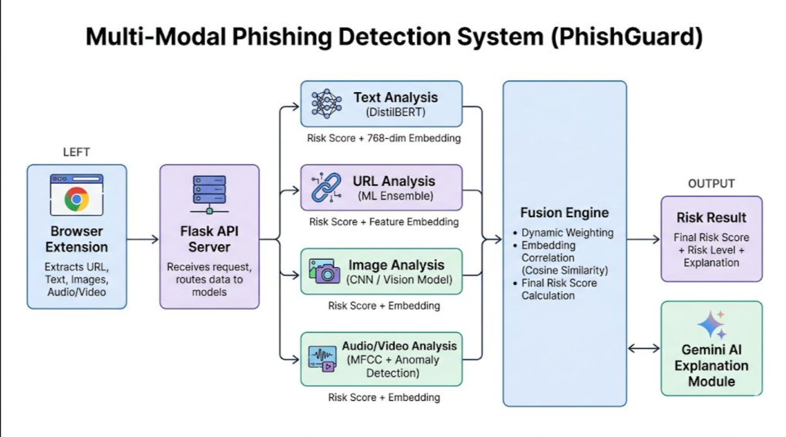
PhishGuard AI - Local Browser Extension for Real-Time Phishing & Deepfake Detection Using a Multi-Modal, Correlation-Aware Pipeline
Results and demo

Slide 13
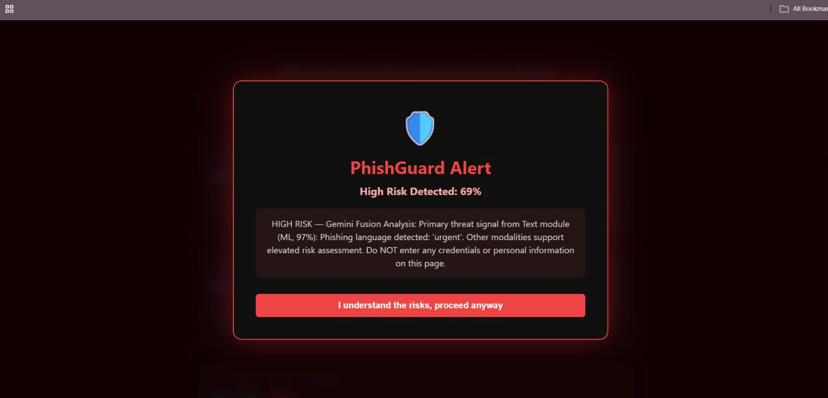
PhishGuard AI - Local Browser Extension for Real-Time Phishing & Deepfake Detection Using a Multi-Modal, Correlation-Aware Pipeline
Results and demo
*

Slide 14
PhishGuard AI - Local Browser Extension for Real-Time Phishing & Deepfake Detection Using a Multi-Modal, Correlation-Aware Pipeline
Individual contribution
Individual contribution
Mallikarjun Reddy: Cloud Architecture (Render.com) & Flask API Deployment.
N Viharika: Fusion Engine Logic (Cosine Similarity & Dynamic Weighting).
Navajyoth: Browser Extension & DOM Extraction Scripts.
Pranav G M: Video and Image Models

Slide 15
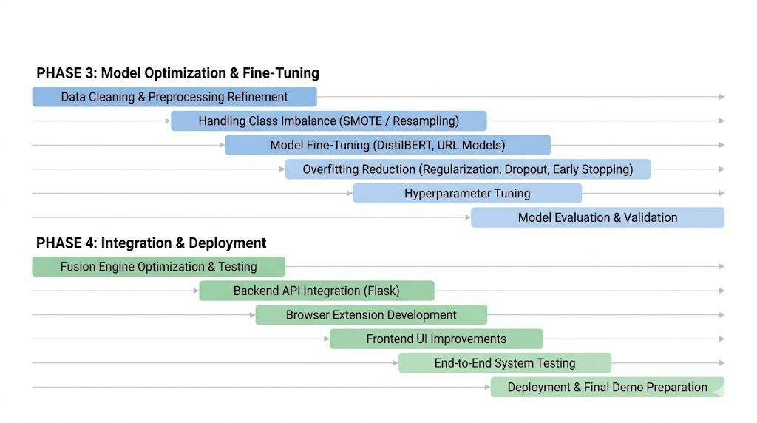
PhishGuard AI - Local Browser Extension for Real-Time Phishing & Deepfake Detection Using a Multi-Modal, Correlation-Aware Pipeline
Project Progress Plan for Phase 3 and Phase 4

Slide 16
PhishGuard AI - Local Browser Extension for Real-Time Phishing & Deepfake Detection Using a Multi-Modal, Correlation-Aware Pipeline
References
[1] A. Aleroud and L. Zhou, "Phishing environments, techniques, and countermeasures: A survey," Computers & Security, vol. 68, pp. 160-196, 2017.
[2] A. K. Jain and B. B. Gupta, "A machine learning based approach for phishing detection using hyperlinks information," Journal of Ambient Intelligence and Humanized Computing, 2018.
[3] N. Das, et al., "Deepfake detection: A comprehensive review," IEEE Access, vol. 9, pp. 152173-152190, 2021.

Slide 17
Mallikarjun_Navajyoth_Pranav_Viharika
PhishGuard AI - Local Browser Extension for Real-Time Phishing & Deepfake Detection Using a Multi-Modal, Correlation-Aware Pipeline
Additional Information
Live Demo: We have made a prototype and are prepared to demonstrate the real-time interception of a deepfake corporate announcement using our server and cloud API.
https://github.com/rjunereddy/capstone

Slide 18
Thank You

